Slide 1
Class Room Training - Instrument Dept.
Differential Pressure Transmitters
Mayank

Slide 2
Contents:
    Basic Function
    Pressure Measurement and Pressure Measuring Terms
    What is Differential Pressure Transmitter?
    Construction of DP Transmitter
    Measuring Principle of DP Transmitter
    Diaphragm Seal Type Transmitter
    Transmitter Selection Guide
    Block Diagram of DP Transmitter
    Installation of DP Transmitter
    Transmitter Valve Manifolds and its operation
    Calibration
    Basic Terms
    Calibration Procedures
    Type of Errors in Calibration
    Transmitter Installation flow Chart
    Troubleshooting
<number>#

Slide 3
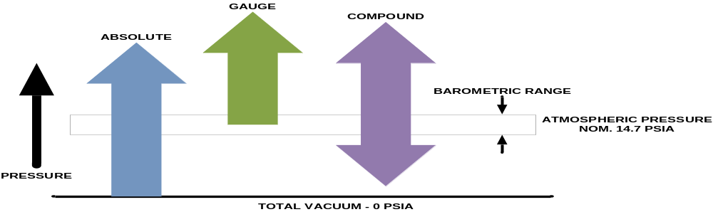
Pressure Measurement
Pressure is the force exerted per unit area
Pressure is the action of one force against another force. Pressure is force applied to, or distributed over, a surface. The pressure P of a force F distributed over an area A is defined as P = F/A
Pressure is experienced when a force is applied to an area. This means that we can increase the pressure by either increasing the force or by reducing the area
We also tend to think of force in terms of weight (this is true, as gravity is assumed to be constant).
<number>#
Notes:
Pressure is defined as the force acting on a unit area.

Slide 4
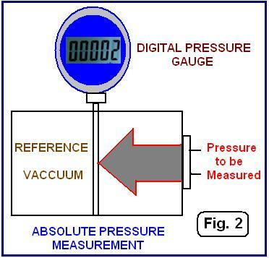
Pressure Measurement Terms
Absolute Pressure
Measured above total vacuum or zero absolute. Zero absolute represents total lack of pressure.
Atmospheric Pressure
The pressure exerted by the earth’s atmosphere. Atmospheric pressure at sea level is 14.696 psia. The value of atmospheric pressure decreases with increasing altitude.
Barometric Pressure
Same as atmospheric pressure.
<number>#
Notes:
When distinguishing between these zero references, the following terms are used:
Absolute pressure is zero referenced against a perfect vacuum, so it is equal to gauge pressure plus atmospheric pressure.
Atmospheric Pressure is the pressure exerted by the earth’s atmosphere. Atmospheric pressure at sea level is 14.696 psia. The value of atmospheric pressure decreases with increasing altitude.

Slide 5
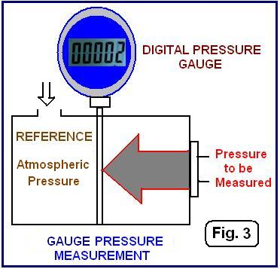
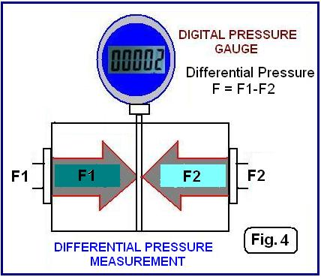
Pressure Measurement Terms
Gauge Pressure
The pressure above atmospheric pressure. Represents positive difference between measured pressure and existing atmospheric pressure. Can be converted to absolute by adding actual atmospheric pressure value.
Differential Pressure
The difference in magnitude between some pressure value and some reference pressure. In a sense, absolute pressure could be considered as a differential pressure with total vacuum or zero absolute as the reference. Likewise, gauge pressure (defined above) could be considered as Differential Pressure with atmospheric pressure as the reference.
<number>#
Notes:
When distinguishing between these zero references, the following terms are used:
Absolute pressure is zero referenced against a perfect vacuum, so it is equal to gauge pressure plus atmospheric pressure.
Atmospheric Pressure is the pressure exerted by the earth’s atmosphere. Atmospheric pressure at sea level is 14.696 psia. The value of atmospheric pressure decreases with increasing altitude.

Slide 6
Pressure Measurement Terms
DP Measurement:
Differential pressure measurement is the basis of other measurements such as flow, level, density, viscosity and even temperature. The most common being level and flow. DP Flow rate measurement is one of the most common applications for differential pressure transmitters.
Differential pressure flow meters have a primary and a secondary element. Generally speaking , the primary element is designed to produce a difference in pressure as the flow increases. There are many different types of primary element, the most common being the Orifice Plate, Venturi, Flow Nozzle and Pitot Tube.
The secondary element of the flow meter is the differential pressure transmitter. It is designed to measure the differential pressure produced by the primary element as accurately as possible.
<number>#
Notes:
When distinguishing between these zero references, the following terms are used:
Absolute pressure is zero referenced against a perfect vacuum, so it is equal to gauge pressure plus atmospheric pressure.
Atmospheric Pressure is the pressure exerted by the earth’s atmosphere. Atmospheric pressure at sea level is 14.696 psia. The value of atmospheric pressure decreases with increasing altitude.

Slide 7
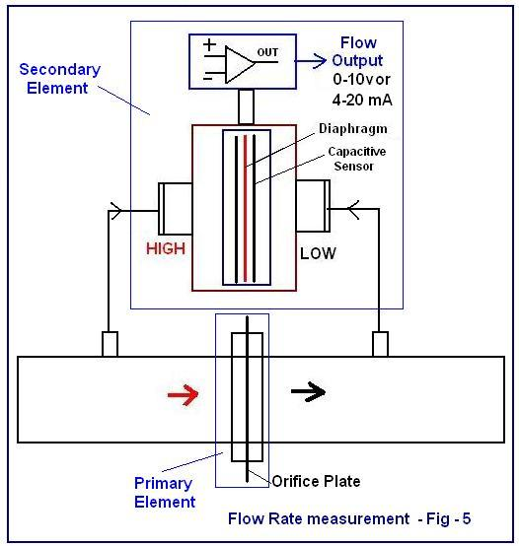
Pressure Measurement Terms
DP Measurement:
In particular it is important that the differential pressure measurement is not affected by changes in the fluid pressure, temperature or other properties such as ambient temperature.
A good DP transmitter will ensure that the differential pressure is measured accurately independent of other changing parameters and will reliably transmit a signal to represent the differential pressure.
The output signal from an industrial DP transmitter is likely to be 4-20mA, but it may also include digital communications such as HART, Profibus Fieldbus, Modbus 485 RTU or one of many other communication protocols.
<number>#
Notes:
When distinguishing between these zero references, the following terms are used:
Absolute pressure is zero referenced against a perfect vacuum, so it is equal to gauge pressure plus atmospheric pressure.
Atmospheric Pressure is the pressure exerted by the earth’s atmosphere. Atmospheric pressure at sea level is 14.696 psia. The value of atmospheric pressure decreases with increasing altitude.

Slide 8
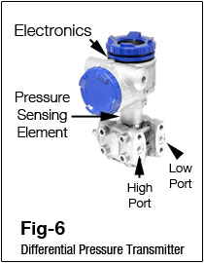
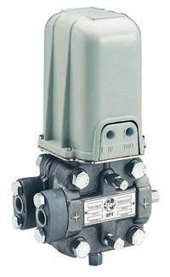
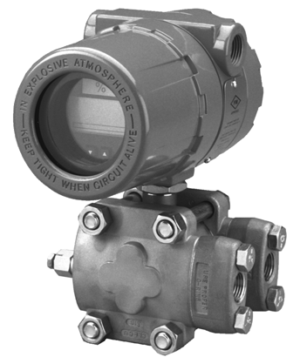
What is a Differential Pressure Transmitter ?
The most common and useful industrial pressure measuring instrument is the differential pressure transmitter.
This equipment will sense the difference in pressure between two ports and produce an output signal with reference to a calibrated pressure range.
The industrial differential pressure transmitters are made of two housings. Pressure sensing element is housed in the bottom half, and the electronics are housed at the top half.
<number>#
Notes:
Electronic pressure transmitters like the one on the left can provide three different types of outputs; a traditional 4 to 20 milliamp analog signal, a HART signal, which is a digital signal superimposed on the analog signal, and a fieldbus digital signal.
Pneumatic transmitters, like the one on the right, provide a 3 to 15 P, S, I pressure signal.

Slide 9
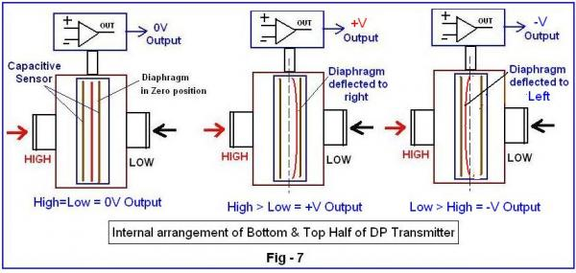
Differential Pressure Transmitter Construction:
A differential pressure transmitter has three functional parts.
1) Direct Pressure sensing element (located in the lower housing):
The majority of industrial DP Transmitters are fitted with diaphragm as the pressure sensing element. This diaphragm is a mechanical device. It is placed in between the two pressure inlet ports. The diaphragm will be deflected by the applied pressure.
This deflection is converted into an electrical signal. This is normally done by the sensors. The commonly used sensor is Differential Capacitance. The sensor output is proportional to the applied pressure.
<number>#
Notes:
Pressure is defined as the force acting on a unit area.

Slide 10
Differential Pressure Transmitter Construction:
2) Electronic Unit:
The electrical signal generated at the lower chamber by the sensor is in the range of millivolt only.
This signal is to be amplified to 0-5V or 0-10V range or is to be converted to 4-20mA for onward transmission to a remote instrument.
This upper housing is the Transmitter portion of the DP Transmitter which houses the Electronic Unit.
3) 2-Wire 4-20mA Current Transmitter:
A DC output current is generated which is directly proportional to the pressure range of the Differential Pressure Transmitter.
The lower range is 4mA, and the upper range is 20mA. This controlled current output is not affected by supply voltage fluctuations.
<number>#
Notes:
Pressure is defined as the force acting on a unit area.

Slide 11
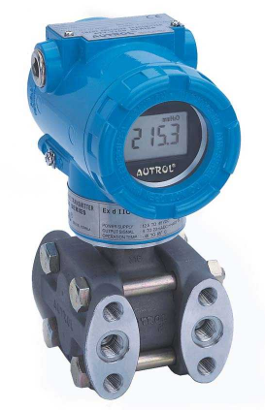
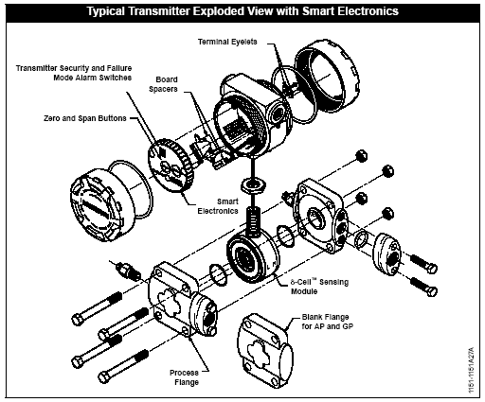
Differential Pressure Transmitter Construction:
<number>#
Notes:
The picture on the left is that of a typical transmitter with an integral indicator and the one on right shows the internal parts.

Slide 12
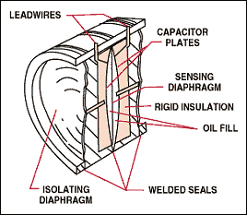
Transmitter Measuring Principle
The diagram shows an electronic differential pressure sensor. This particular type utilizes a two-wire capacitance technique.
Process pressure is transmitted through isolating diaphragms and silicone oil fill fluid to a sensing diaphragm.
The sensing diaphragm is a stretched spring element that deflects in response to the differential pressure across it.
The displacement of the sensing diaphragm is proportional to the differential pressure.
The position of the sensing diaphragm is detected by capacitor plates on both sides of the sensing diaphragm.
The differential capacitance between the sensing diaphragm and the capacitor plates is converted electronically to a 4–20 mA or 1-5 VDC signal.
For a gauge pressure transmitter, the low pressure side is referenced to atmospheric pressure.
<number>#
Notes:
This describes how a gauge pressure transmitter works.

Slide 13
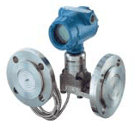
Diaphragm Seal System
A diaphragm seal system consists of a pressure transmitter, diaphragm seals, a fill fluid, and either a direct mount or capillary style connection.
During operation, the thin, flexible diaphragm and fill fluid separate the pressure sensitive element of the transmitter from the process medium. The capillary tubing or direct mount flange connects the diaphragm to the transmitter.
When process pressure is applied, the diaphragm transfers the measured pressure through the filled system and capillary tubing to the transmitter element.
This transferred pressure displaces the sensing diaphragm in the pressure-sensitive element of the transmitter.
The displacement is proportional to the process pressure and is electronically converted to an appropriate current, voltage, or digital HART output signal.
<number>#
Notes:
Please take a few minutes to review the uses of a diaphragm seal system.

Slide 14
Diaphragm Seal System
WHY USE DIAPHRAGM SEALS?
Diaphragm Seal systems provide a reliable process pressure measurement and prevent the process medium from contacting the transmitter diaphragm.
Transmitter/ Diaphragm Seal systems shall be used for:
  For process fluid that would clog the pressure elements.
  For process fluids that are toxic, corrosive, slurry and viscous.
  For process fluids that could freeze or solidify.
  For process temperatures outside the normal operating range and cannot be brought to those limits by impulse piping.
  For process that needs frequent cleaning.
  For processes that need replacement of wet legs, to reduce maintenance.
<number>#
Notes:
Basic uses of a diaphragm seal system.

Slide 15
Pressure Transmitter Selection Guideline
  When selecting a pressure transmitter care should be given to a number of parameters which have an effect on transmitter accuracy, safety, and utility.
  Accuracy required
  Power supply
  Operating pressure range
  Operating temperature range
  Body Material
  Pressure fluid composition and Internal parts
  Mounting requirement
  Process connection size
<number>#
Notes:
This gives the basic guidelines on selecting a Pressure Transmitter.

Slide 16
Pressure Transmitter Selection Guideline
  Selection of Pressure Instruments:
  Rules of Thumb:
  Application:
  Understand your application. Examine the particulars of your application.
  Is it necessary to know if the pressure is negative or positive?
  Do you need to know the difference in pressure between two points?
  Answering these questions about your application will go a long way in helping select the right pressure transmitter.
  Wetted Parts:
  Selecting the transmitter with wetted parts that are compatible with the medium to be measured helps to ensure a long-lasting measurement solution.
<number>#

Slide 17
Pressure Transmitter Selection Guideline
Accuracy:
From an accuracy point of view, the range of a transmitter should be low (normal operating pressure at around the middle of the range), so that error, usually a percentage of full scale, is minimized.
On the other hand, one must always consider the consequences of overpressure damage due to operating errors, faulty design, or failure to isolate the instrument during pressure-testing and start-up.
Therefore, it is important to specify not only the required range, but also the amount of overpressure protection needed.
Output Required:
  Pressure transmitters can send the process pressure of interest using an analog pneumatic (3-15 psig), analog electronic (4-20 mA dc), or digital electronic signal.
Protection:
  Do you need special protection from the elements? Many applications require special protection, such as, corrosive environment, or an outdoor environment.
<number>#

Slide 18
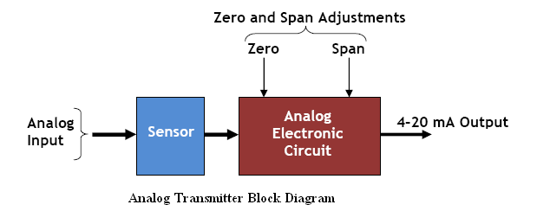
Block Diagram- DP Transmitter (Analog)
SMART Transmitters:
A smart transmitter is remarkably different from that of a conventional analog transmitter. Consequently the calibration methods for both devices are also very different. Remember that calibration refers to the adjustment of an instrument so its output accurately corresponds to its input throughout a specified range. Therefore a true calibration requires a reference standard, usually in the form of one or more pieces of calibration equipment to provide an input and measure the resulting output.
<number>#
Notes:
This describes how a gauge pressure transmitter works.

Slide 19
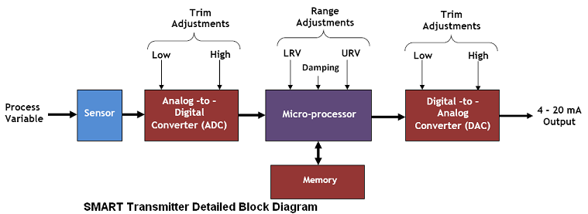
Block Diagram- Transmitter (SMART)
To fully understand the main components of a smart transmitter, a simplified block diagram of the device is shown above. The procedure for calibrating a smart digital transmitter is known as Digital trimming.
A digital trim is a calibration exercise that allows the user to correct the transmitter’s digital signal to match plant standard or compensate for installation effects.
Digital trim in a smart transmitter can be done in two ways:
A Sensor Trim: It consist of matching the process variable (be it pressure, level, flow or temperature) reading of the transmitter to a precision input. This process normally involves trimming the digital circuit of the input Analog-to-Digital converter in the smart transmitter.
A 4–20mA or Current Loop Trim: This is done by trimming the output Digital-to-Analog converter in the transmitter.
<number>#
Notes:
This describes how a gauge pressure transmitter works.

Slide 20
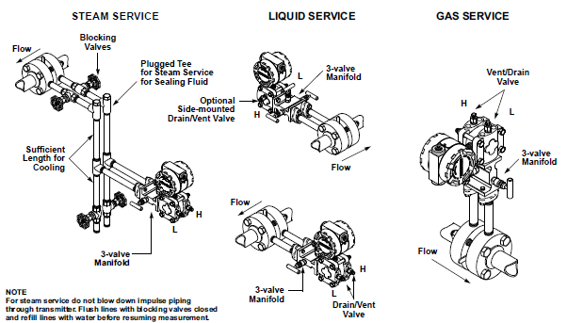
Pressure Transmitter installation
<number>#
Notes:
This is an example of a pressure transmitter installation detail.

Slide 21
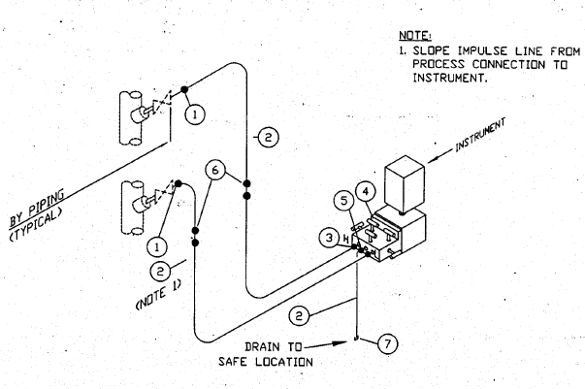
Pressure Transmitter installation
Mounting above tap is typical for gas service and mounting below tap typical for liquid and steam services.
Direct mount is possible for low temperature services.
<number>#
Notes:
This is an example of a pressure transmitter installation detail.

Slide 22
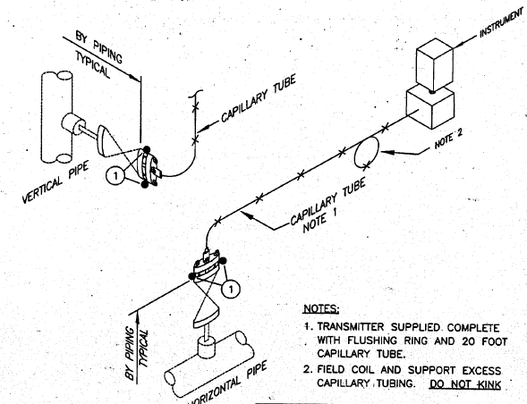
Diaphragm Seal installation
<number>#
Notes:
This is an example of an installation detail of a pressure transmitter using a diaphragm seal system.

Slide 23
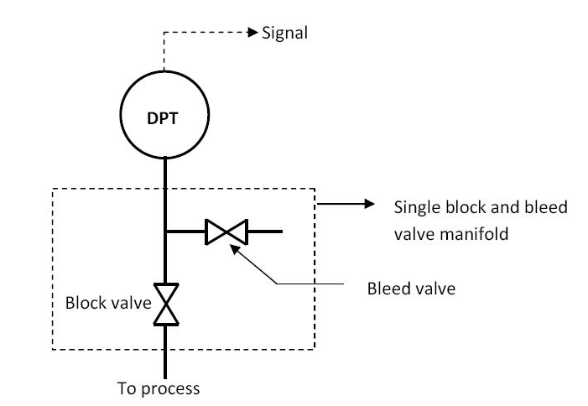
Transmitter-Valve Manifolds
Single Block and Bleed Valve Manifold:
Transmitter valve manifolds also come in single block-and-bleed configurations. In this scenario, the transmitter is being used for gauge pressure applications. Here, the “low” pressure port of the transmitter is vented to atmosphere, with only the “high” pressure port connected to the process medium through impulse lines.
The schematic diagram shows the single block and bleed valve manifold.
Removing the DP transmitter (DPT in diagram above) is very easy. Simply close the block valve and open the bleed valve to vent process pressure to the atmosphere. The DP transmitter is already out of service. Putting the transmitter back into operation is also easy. Ensure that both bleed and block valves are initially closed. Then open the block valve and the transmitter is back to service.
<number>#
Notes:
This completes the Control Systems Training Module 000.270.CSE156.1 Flow Instruments. Are there any questions?

Slide 24
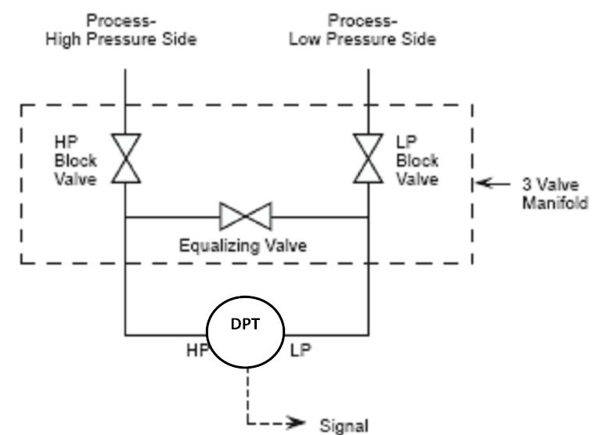
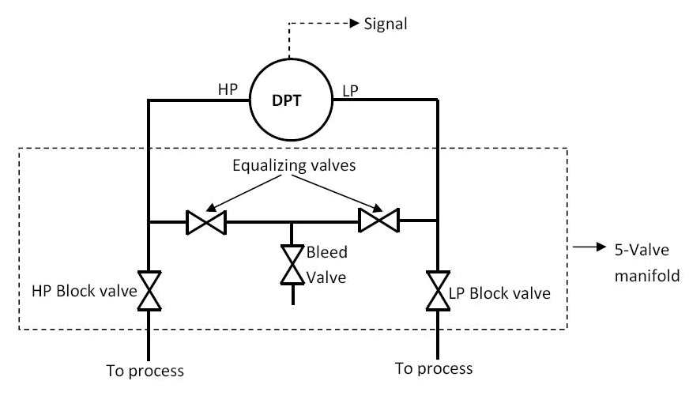
Transmitter-Valve Manifolds
An important accessory to the DP transmitter is the valve manifold. Most DP transmitters come with either a 3-valve manifold or a 5-valve manifold or a single block and bleed valve manifold depending on the application. The valve manifold is used:
To isolate the DP transmitter from the process for maintenance and calibration.
To ensure that the DP transmitter is not over-ranged
3-Valve Manifold: This device incorporates three manual valves to isolate and equalize pressure from the process to the transmitter, for maintenance and calibration purposes. It consists of two block valves - high pressure and low pressure block valve - and an equalizing valve.
5-Valve Manifold: During normal operation, the HP and LP valves are open while the equalizing valves and the bleed valve are closed. However,
<number>#
Notes:
This completes the Control Systems Training Module 000.270.CSE156.1 Flow Instruments. Are there any questions?

Slide 25
How to Operate Manifold with Transmitters
Sequence for Valve operation in DP Transmitter with a 3-Valve Manifold into Service:
Check all valves : HP, LP and the equalizing valve are closed.
Open the equalizing valve. This ensures that the same pressure will be applied to both sides of the transmitter, i.e. zero differential pressure.
Open the High Pressure block valve slowly, check for leakage from both the high pressure and low-pressure side of the transmitter.
Close the equalizing valve. This locks the pressure on both sides of the transmitter.
Open the low-pressure block valve to apply process pressure to the low-pressure side of the transmitter and establish the working differential pressure.
The transmitter is now in service.
Removing The 3-Valve Manifold DP Transmitter from Service: The DP transmitter can be removed from service using the steps outlined below:
Close the low-pressure block valve.
Open the equalizing valve.
Close the high-pressure block valve.
Open one by one both the ports of the transmitters to release trapped process pressure inside the t capsule housing of transmitter.
The transmitter is now out of service.
<number>#
Notes:
This completes the Control Systems Training Module 000.270.CSE156.1 Flow Instruments. Are there any questions?

Slide 26

Calibration - Basic Terms
    Accuracy: The accuracy of a measurement system is the degree of closeness of measurements of a quantity to that quantity's actual (true)values.
    Precision: The precision of a measurement system, also called reproducibility or repeatability, is the degree to which repeated measurements under unchanged conditions show the same results.
Not accurate
Not precise
More accurate
Less precise
Less accurate
More Precise
Accurate
Precise

Slide 27
Basic Terms
    Sensitivity: The sensitivity of an instrument is the smallest amount it can measure, of whatever it's built to measure.
    Range: The region between the limits within which a quantity is measured, received or transmitted. It is expressed by stating the lower and upper range values.
    Span: The algebraic difference between the upper and lower range values expressed in the same units.

Slide 28
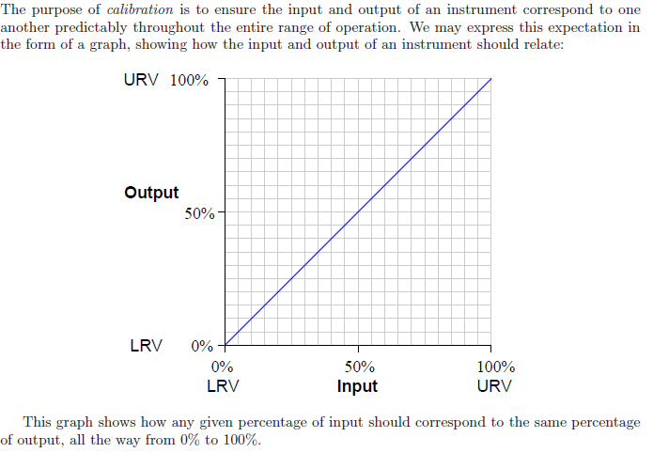
Calibration Procedures

Slide 29
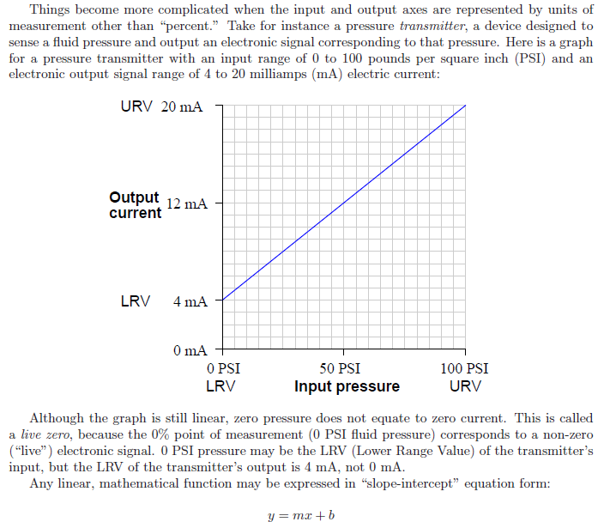
Calibration Procedures

Slide 30
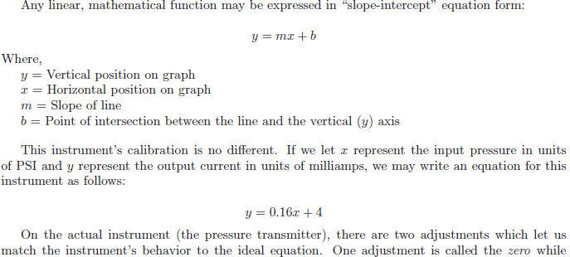


Calibration procedures

Slide 31
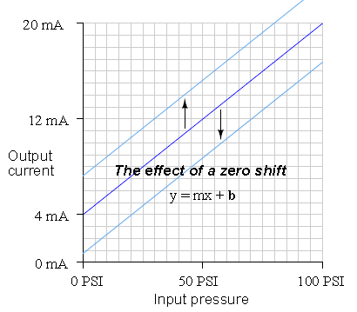
Calibration Error
Zero shift:
Calibration error shifts the function vertically on the graph, which is equivalent to altering the value of b in the slope-intercept equation. This error affects all calibration points equally, creating the same percentage of error across the entire range
Where,
y = Vertical position on graph
x = Horizontal position on graph
m = Slope of line
b = Point of intersection between the line and the vertical (y) axis

Slide 32
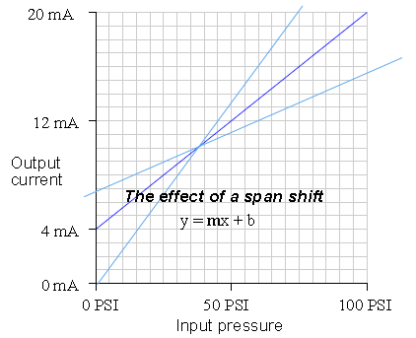
Calibration Error
Span shift:
Calibration error shifts the slope of the function, which is equivalent to altering the value of m in the slope-intercept equation. This error’s effect is unequal at different points throughout the range.

Slide 33
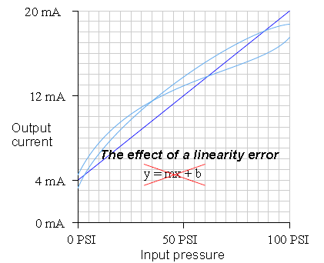
Calibration Error
Linearity:
Calibration error causes the instrument’s response function to no longer be a straight line. This type of error does not directly relate to a shift in either zero (b) or span (m) because the slope-intercept equation only describes straight lines.

Slide 34
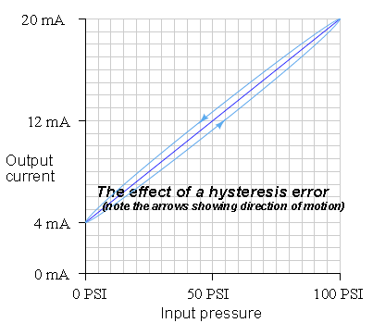
Calibration Error
Hysteresis:
Calibration error occurs when the instrument responds differently to an increasing input compared to a decreasing input. The only way to detect this type of error is to do an up-down calibration test, checking for instrument response at the same calibration points going down as going up.

Slide 35
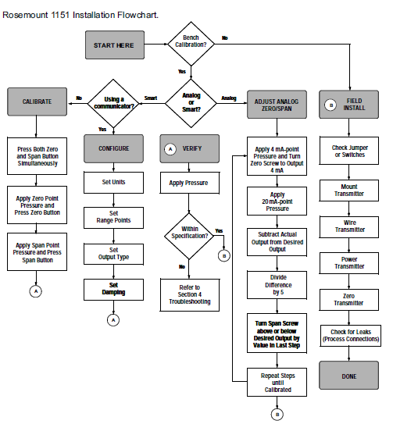

Slide 36
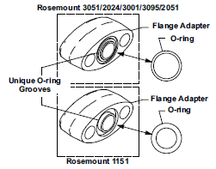

Seal Tightening Procedure

Slide 37
Thanks

